Slide 1
EDUVISION_DV
Higher Education
Intelligence System
DATA
→
Institutional Performance & Academic Excellence Analysis
INSIGHT
→
FINAL INTERNSHIP PRESENTATION
DECISION
Presented by
Mohammad Saad
University • Research
Students • Country
Internship Project • 2026
Final presentation for internship review

Slide 2
01 • EXECUTIVE STORY
From fragmented education data to decision-ready intelligence
One connected BI experience across institutional, research, student and country perspectives.
THE CHALLENGE
THE APPROACH
THE PRODUCT
THE OUTCOME
Education data arrives in different structures, scales and levels of detail.
Clean → standardize → model → engineer KPIs → visualize → validate.
Four interlinked analytical dashboards built for fast exploration.
A portfolio-ready evidence layer for higher-education performance analysis.
THE STORY IN ONE LINE
We turned multiple education datasets into a single analytical journey —
from “How is a university performing?” to “What is happening behind the numbers?”
EduVision_DV • Higher Education Intelligence System
02

Slide 3
02 • BUSINESS CONTEXT
Why EduVision_DV was built
Project objective: make higher-education performance easier to explore, compare and explain.
01
02
Problem
Objective
• University, research, student and country indicators exist in separate datasets.
• Different granularities make direct joining risky and can distort analytical results.
• Decision-makers need a fast way to move from headline KPIs to supporting evidence.
• Create a structured analytical layer with consistent university/country identifiers.
• Build KPI-driven dashboards without inventing unsupported metrics.
• Provide a guided dashboard journey with navigation and interactive exploration.
DESIGN PRINCIPLE • Preserve source meaning first; compare only where the data supports comparison.
EduVision_DV • Higher Education Intelligence System
03

Slide 4
03 • DELIVERY JOURNEY
Five stages from raw data to final project
Your GitHub branch documents the work across Milestones 1–4, followed by the Final Project package.
01
02
03
04
05
DATA COLLECTION & PREPARATION
KPI ENGINEERING
TABLEAU DEVELOPMENT
TESTING & DOCUMENTATION
FINAL PROJECT
→
→
→
→
Clean source datasets
Document quality
Analytical model
Defensible measures
Four dashboards
Navigation & interaction
QA checklist
Testing report & docs
Final PPT
Public dashboard link
GitHub organization
Milestone_1 • Milestone_2 • Milestone_3 • Milestone_4 • Final Project
EduVision_DV • Higher Education Intelligence System
04

Slide 5
04 • DATA FOUNDATION
Four source families — four analytical roles
Each source is used for the questions its fields can actually support.
QS 2025
University Overview
THE 2024
Research Analytics
Rankings, academic reputation, overall score,
internationalization & research-related scores
Research, citations, teaching,
student-staff & international outlook
WUR 2023
Students Analytics
WORLD BANK
Country Comparison
Total students, student-staff ratio,
international students & gender indicators
Country/year education indicators,
expenditure, enrollment, literacy & GDP
Analytical grain is preserved instead of forcing every source into one giant table.
EduVision_DV • Higher Education Intelligence System
05

Slide 6
05 • DATA ENGINEERING
A modular analytical layer keeps the data explainable
University, research, student and country facts remain distinct while sharing common identifiers.
RAW
CLEAN
MASTER IDs
FACTS
BI
→
→
→
→
Source files
Standard names
& types
University / Country
Performance
Research / Student / Country
Tableau dashboards
QUALITY RULE
ID RULE
BI RULE
Do not fabricate missing values or force unrelated columns to represent a KPI.
Use university_id, country_id and year as the shared analytical keys.
Avoid a giant many-to-many join that can duplicate measures.
EduVision_DV • Higher Education Intelligence System
06

Slide 7
06 • KPI ENGINEERING
Six core KPI concepts anchor the dashboard experience
Definitions are tied to source fields and documented methodology rather than arbitrary substitutions.
GLOBAL RANKING
RESEARCH IMPACT
FACULTY / STUDENT
QS 2025 rank / ranking view
Citations per Faculty Score
Student–staff ratio
Institutional position
Research visibility
Learning capacity
INTERNATIONAL STUDENTS
ACADEMIC REPUTATION
RESEARCH PRODUCTIVITY
Actual percentage where available
QS Academic Reputation Score
Derived only when formula is documented
Global participation
Academic perception
Research efficiency
KEY MESSAGE • A KPI is useful only when its definition is reproducible and its source meaning is preserved.
EduVision_DV • Higher Education Intelligence System
07

Slide 8
07 • DASHBOARD SUITE
Four dashboards. One analytical journey.
Each dashboard answers a different question while the navigation keeps the experience connected.
01
02
03
04
UNIVERSITY OVERVIEW
RESEARCH ANALYTICS
STUDENTS ANALYTICS
COUNTRY COMPARISON
How is the institution performing?
What is happening behind research performance?
What does the student profile look like?
What is the wider education context?
Rank • reputation • research • internationalization
Research • citations • teaching • outlook
Enrollment • ratio • international • gender
Spending • enrollment • literacy • teachers
NAVIGATION
University → Research → Students → Country
EduVision_DV • Higher Education Intelligence System
08

Slide 9
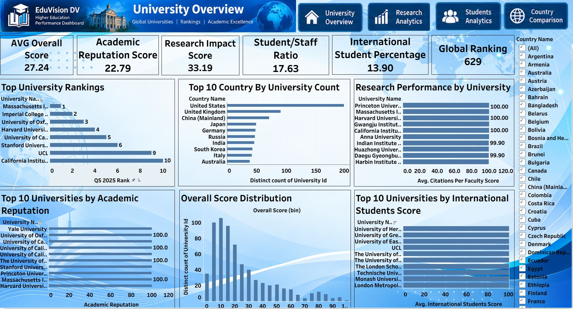
09 • DASHBOARD
University Overview
Executive snapshot of institutional performance, ranking position and international profile.
OVERALL SCORE
27.24
ACADEMIC REPUTATION
22.79
RESEARCH IMPACT
33.19
STUDENT / STAFF
17.63
INTERNATIONAL STUDENTS
13.90
GLOBAL RANKING
• Filters and ranking views support rapid institution-level exploration.
629
WHAT TO NOTICE
EduVision_DV • Higher Education Intelligence System
09

Slide 10
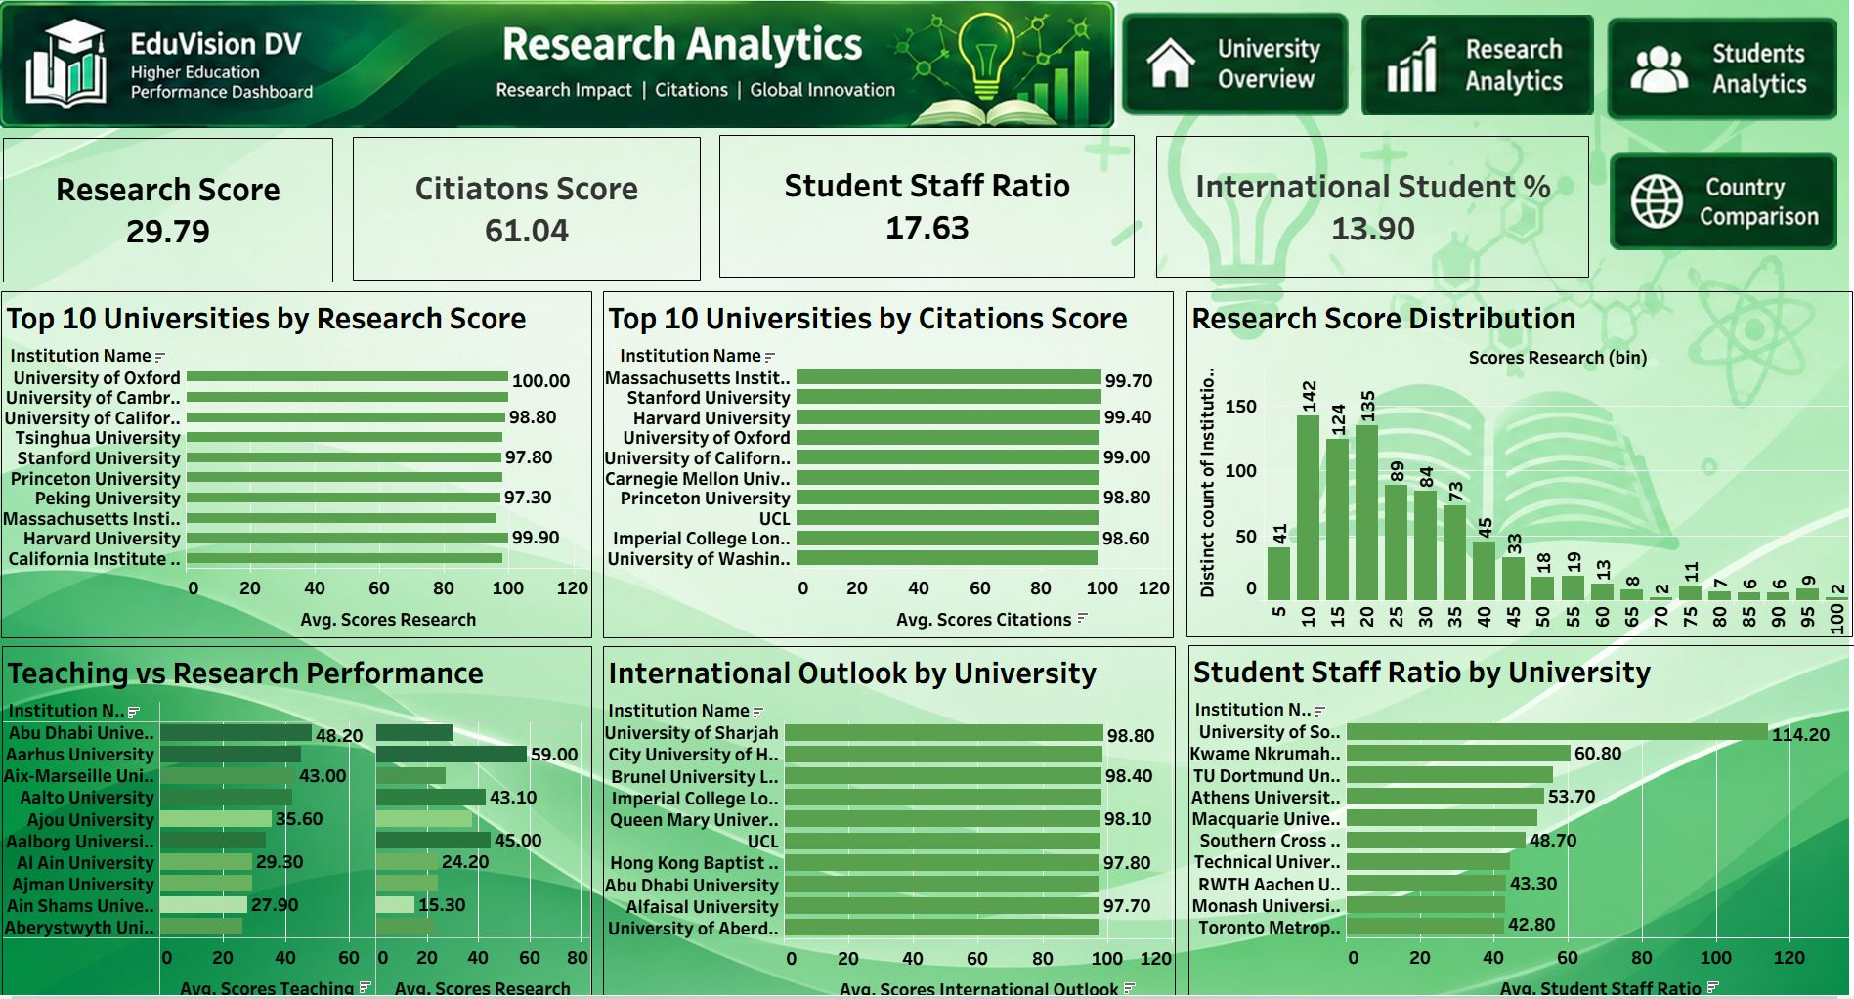
10 • DASHBOARD
Research Analytics
Research evidence layer: research strength, citations, teaching, outlook and student–staff context.
RESEARCH SCORE
29.79
CITATIONS SCORE
61.04
STUDENT / STAFF
17.63
INTERNATIONAL STUDENTS
13.90
WHAT TO NOTICE
• Research score and citation views make research performance visible at university level.
EduVision_DV • Higher Education Intelligence System
10

Slide 11
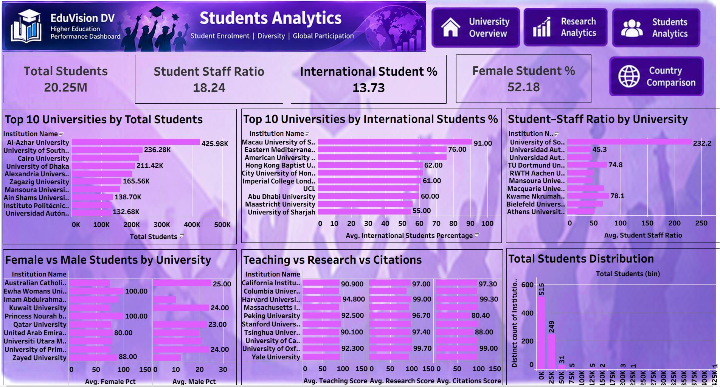
11 • DASHBOARD
Students Analytics
Student profile view covering enrollment scale, international participation, ratios and gender indicators.
TOTAL STUDENTS
20.25M
STUDENT / STAFF
18.24
INTERNATIONAL STUDENTS
13.73
FEMALE STUDENTS
52.18
WHAT TO NOTICE
• The dashboard combines scale, participation and diversity measures in one view.
EduVision_DV • Higher Education Intelligence System
11

Slide 12
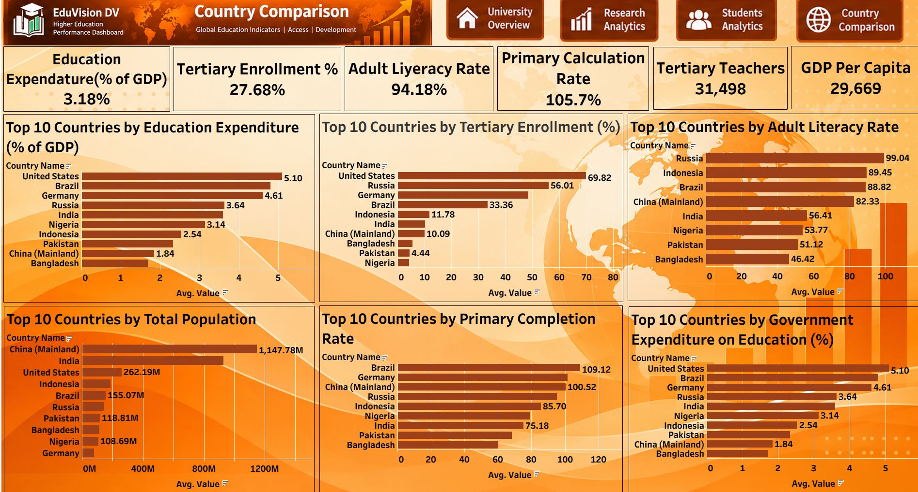
12 • DASHBOARD
Country Comparison
Country-level education context connecting institutional analysis to the wider ecosystem.
EDUCATION EXPENDITURE
3.18%
TERTIARY ENROLLMENT
27.68%
ADULT LITERACY
94.18%
PRIMARY COMPLETION
105.7%
TERTIARY TEACHERS
31,498
GDP PER CAPITA
29,669
WHAT TO NOTICE
• Country indicators provide context for access, investment and education-system capacity.
12
EduVision_DV • Higher Education Intelligence System

Slide 13
13 • ANALYTICAL JOURNEY
A presenter can move from headline KPI to supporting evidence
The dashboard suite is designed to tell a continuous story rather than four isolated screens.
START
DRILL
PROFILE
CONTEXT
University Overview
→
Research Analytics
→
Students Analytics
→
Country Comparison
Headline performance
Research + citations
Scale + participation
System-level context
PRESENTATION FLOW
Question → KPI → supporting visual → comparison → context
EduVision_DV • Higher Education Intelligence System
13

Slide 14
14 • DASHBOARD INSIGHTS
What the completed views make easier to see
These are dashboard-level observations from the displayed measures — not causal claims.
RANKING & REPUTATION
The University Overview surfaces top-ranked institutions alongside academic reputation and internationalization measures.
RESEARCH EVIDENCE
Research Analytics exposes separate research and citation scores, helping distinguish research strength from citation visibility.
STUDENT PROFILE
Students Analytics makes enrollment scale, international participation and student–staff ratios visible together.
COUNTRY CONTEXT
Country Comparison adds education spending, enrollment, literacy and economic context to the institutional story.
The value is not one number — it is the ability to move between complementary measures.
EduVision_DV • Higher Education Intelligence System
14

Slide 15
15 • TESTING & DOCUMENTATION
Milestone 4: turning the dashboard into a reviewable deliverable
QA covers KPI mapping, ranking logic, dashboard interaction, educational metrics and project documentation.
✓
✓
✓
✓
✓
STRUCTURE
KPI QA
RANKING QA
INTERACTION QA
DOCUMENTATION
4 dashboards present
Packaged Tableau workbook
Field-to-KPI mapping
Definitions documented
Rank fields checked
Top-ranking views tested
Navigation verified
Filter behavior tested
Sources • methodology
Dashboard guide • QA report
QA NOTE
Dashboard-wide visual selections can make KPI cards in some interactions.
EduVision_DV • Higher Education Intelligence System
15

Slide 16
16 • FINAL PROJECT DELIVERY
GitHub documentation + public dashboard handoff
The Final Project folder is intentionally small: the final presentation and the complete public dashboard link.
GITHUB BRANCH
TABLEAU PUBLIC
springboardmentor1234r/
Higher-Education-Intelligence-System-for-Institutional-Performance-and-Academic-Excellence-Analysis
/tree/Mohammad_Saad
LIVE DASHBOARD LINK
https://public.tableau.com/app/profile/mohammad.saad.mohammad.sohrab/viz/EduVision_DV_17910379007560/UniversityOverview#1
EduVision_DV • Higher Education Intelligence System
16

Slide 17
FINAL TAKEAWAY
From Data → Insight → Decision
EduVision_DV connects institutional performance, research evidence,
student profiles and country context in one analytical story.
TRACEABLE
INTERCONNECTED
PRESENTATION-READY
Source-faithful measures
Four dashboard perspectives
Documented, testable delivery
Thank you
Questions & Discussion
Mohammad Saad • EduVision_DV • Final Internship Presentation

